Slide 1
DIP – Final Project BackLight Image Process
組員：柯劭函、游庭維、林宗翰、謝承佑

Slide 2
目標
人物為主角的背光補償
假設光源在後方
假設人物在圖片中央
避免 histogram equalization 造成的過曝

Slide 3
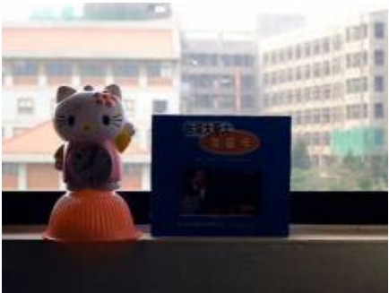
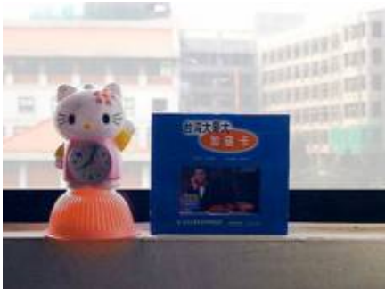
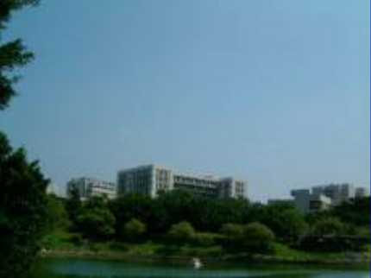
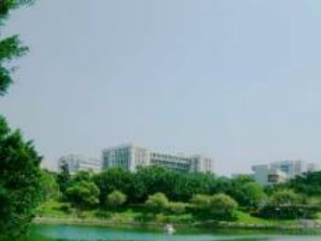
Problem？？

Slide 4
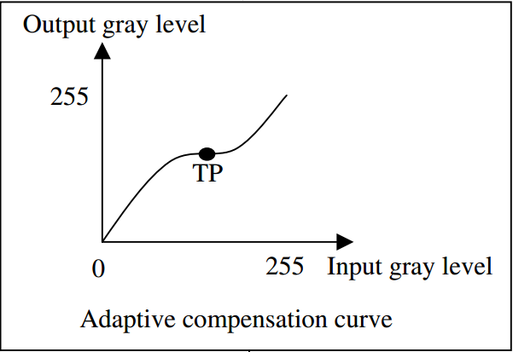
Basic Concept
Input Image
Detect
if backlight or not？
NO
Other Image Problem
Yes
Backlight with high degree
Compensated Image

Slide 5
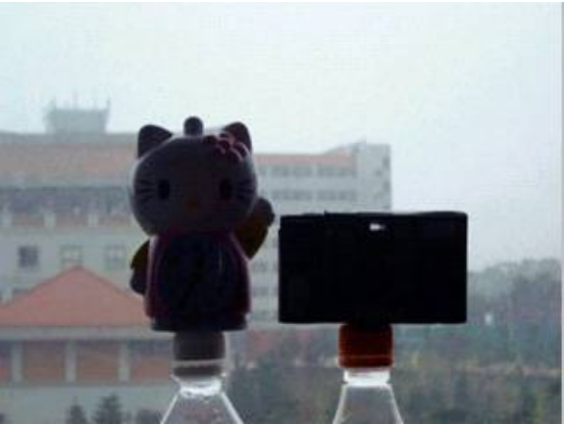
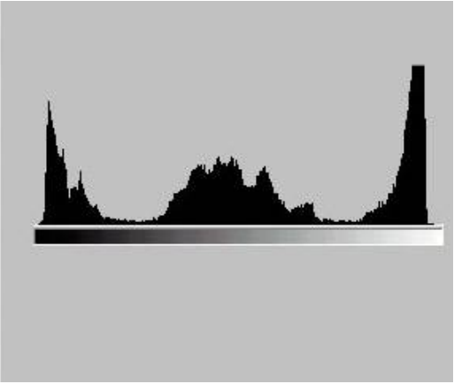
Detection Phase
透過image和histogram兩個方向，得出兩個backlight degree，最後利用fuzzy logic，歸納出最後的backlight degree。
Image
Histogram

Slide 6
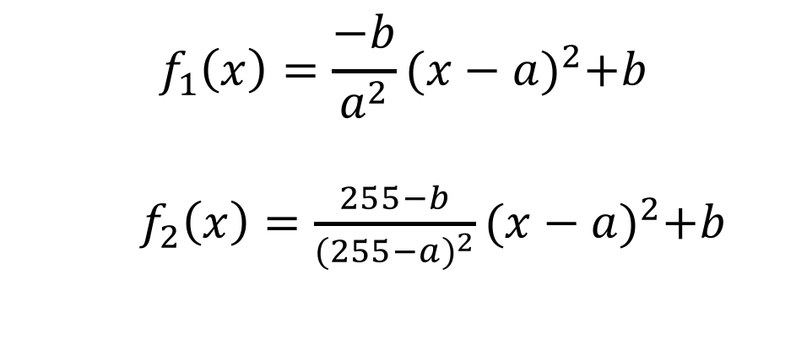
Transformation Function - 1
$$f_{1}\left(x\right)=\frac{−b}{a^{2}}{(x−a)}^{2}+b$$
$f_{2}\left(x\right)=\frac{255−b}{{(255−a)}^{2}}{(x−a)}^{2}+b$

Slide 7
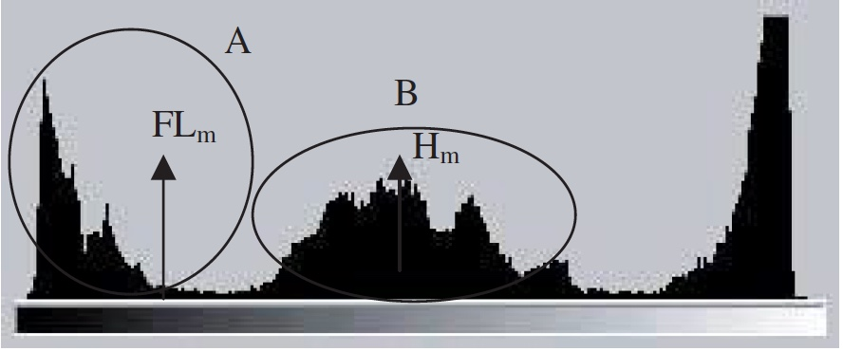

Transformation Function - 2
$$\left(a, b\right)=({FL}_{m}, H_{m})$$

Slide 8
Grouping

Slide 9

It’s DEMO time！！！

